Slide 1
Kotlin DSL for Business Processes Automation in Telecom and Underlying Engine for their Execution
Kirill D. Kreslavski
Academic Supervisor: Marina G. Ivanova, lead engineer at Nexign

Slide 2
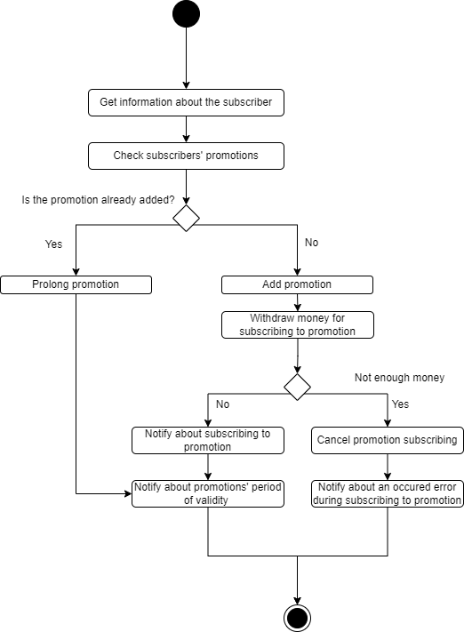
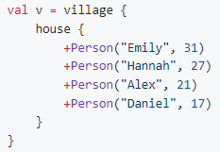
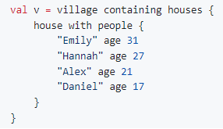
Introduction to domain
DSL – Domain Specific Language, in this case basically a small programming language for our specific domain inside another programming language - Kotlin.
Great Kotlin DSL examples can be found here github.com/zsmb13/VillageDSL
Example business process in telecom

Slide 3

Motivation
Nexign — russian IT company, OSS/BSS software
and business digitalization solutions developer, Russia’s first
telecom billing software developer.
Nexign has a product called CRAB, which basically is a high-load business scenario execution system and the problem is that Scenario describing and developing is not fast and the result is long and messy piece of code with the description of all transitions, conditions, states and procedures.
What is desired is a Kotlin DSL, that would help structurize and simplify the development of Scenarios and reduce an amount of Java boilerplate and human-factor errors.

Slide 4
Goals and Tasks
Global goal: develop effective Kotlin DSL for short, readable scenarios description and a compact engine for their execution, reducing amount of “human factor” errors (e.g. typos, types compatibility errors, etc.)
Research and analyze existing analogues, their advantages and disadvantages
Develop DSL and add more new functionality
Develop Production ready and Testing engines
Autotests cover
Proof of the concept, functionality check. Get user experience feedback

Slide 5
Comparison with analogues 1
Frameworks / libraries and products for business processes/scenarios descriptioning and development
Cadence – Golang BPMN engine with libraries in Go, Java, Python and Ruby. Open source. Gigantic, covers the whole BPMN functionality, therefore is very complex. Lots of options and preferences for all and everything. Overexpandable for almost anything. Shortly said – overkill. | Temporal – BPMN framework, based on Cadence, easier in exploitation and customization, also Open source, also Java. | iWF – BPMN framework based on Cadence, even easier than Temporal.
Common issue – transitions definition is smeared in all across the code, no single-point for scenario description, not humanly readable.

Slide 6
Comparison with analogues 2
Frameworks / libraries and products for finite state machines development
Name | Short description | Has an execution engine | Automatic picture generation from code
KStateMachine | Quite compact framework, but now it is all the way around – all the operations, what they do, their code must be declared in one place, which is bad for decomposition | +/- | -
StateMachine (tinder.com) | Pure State Machine Builder, useful job can only be done via side effects from transitions, the states are just states. It also becomes a quite long spaghetti. | - | -
KFSM | Decent framework, provides api as exactly Kotlin DSL, but describing even a tiny State Machine takes a lot of code and space for no meaningful reason. | - | +

Slide 7
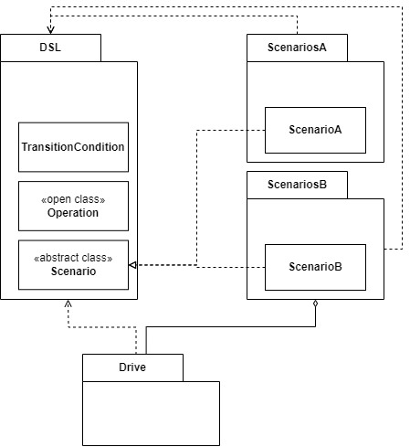
Our solution
Scenario packages require only to know how to describe the scenarios - our DSL. And they totally shouldn’t care how the Engine insides work. The Engine itself should only know how to interpret the scenarios - our DSL. It can consume the Scenario classes as already prepared JARs.

Slide 8
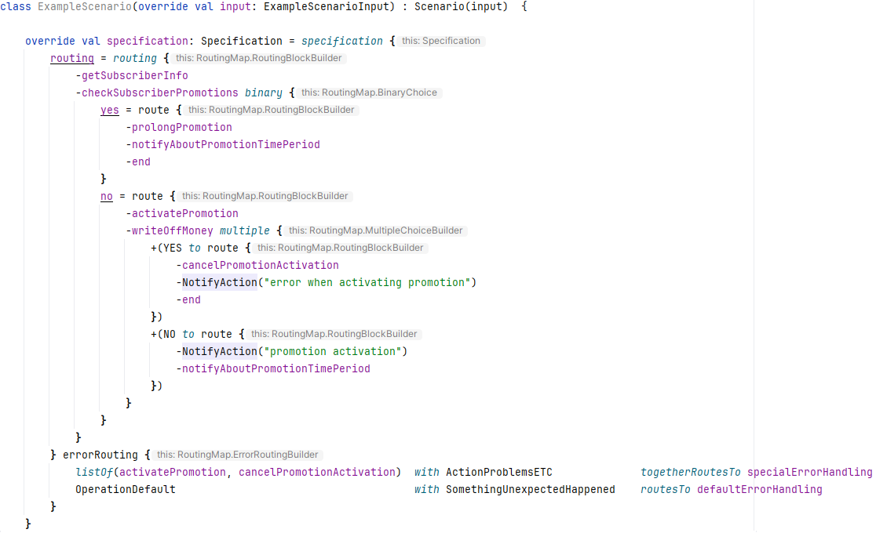
Our solution

Slide 9
Solved tasks
Developed a quite comprehensive DSL
Created a Formal Language structure architecture for DSL
As much uncluttered descriptions for Operations as possible
Concise Transitions description
Description for high-level error handling
Separated DSL, Engine entities and Scenarios packages
The Engine is built standalone and uses DSL as a library dependency
DSL knows nothing about internals of the Engine
For descriptioning and development of Scenarios only DSL is needed
Automatic human-readable Scenario description generation (as text in english) from code
Human-readable scenario execution logs

Slide 10
In Progress
Engine enhancements and improvements
Try to create a way to provide external dependencies via Kotlin Context (experimental)
Automatic generation of Scenarios description as xml specifications and as schematic graph images
The same for Scenario execution log
Add REST API service
Improve multi-threading
Write auto-tests and add testing to CI/CD
Write more documentation

Slide 11

Results
repository

